Slide 1

IMDB Movie Review Sentiment Analysis
Team Members:
Srilakshmi Parella (11697665)
Roopadevi Ambati (11702517)
Siva Kumar Chaini (11676099)
Rohith Kumar Arvapally (11694004)
Srimannarayana Vakalapudi (11819166)

Slide 2
Agenda
Project Statement & Overview
Flow Diagram
Dataset Characteristics
Experiment Methodology
Results & Visual Insights
Model Evaluation
Limitations & Future Work
Conclusion
References

Slide 3
Problem Statement
This project involves comparing the performances of various machine learning and deep learning models used to classify IMDB movie reviews as positive or negative. We compare Naive Bayes, Support Vector Machines (SVM), Random Forest, Decision Trees, and Long Short-Term Memory (LSTM) networks based on accuracy, precision, recall, and F1-score.
Our findings indicate that the LSTM model performs best in terms of accuracy (87.65%), with Naive Bayes (84.91%) and Random Forest (84.72%) in second and third places, respectively.
The SVM and Decision Tree models performed worse, indicating the inability to manage high-dimensional text data. The present research contributes to model choice for sentiment analysis tasks.

Slide 4
Introduction
The automated sentiment analysis system extracts subjective opinions from text data so business organizations can conduct large-scale public sentiment measurement. A total of 50,000 reviewed movies from IMDB provides perfect conditions for testing different classification systems.
This research performs a comprehensive analysis through which five machine learning approaches of diverse types are evaluated across conventional and deep learning paradigms alongside detailed assessment of preprocessing effects on model performance. Every script and visualization have been released publicly with the aim to enable full reproducibility along with support for additional studies within this domain.

Slide 5
Sentiment analysis generally includes:
Text preprocessing (tokenization, stop word removal, stemming)
Feature extraction (TF-IDF, word embeddings)
Classification with supervised learning techniques

Slide 6
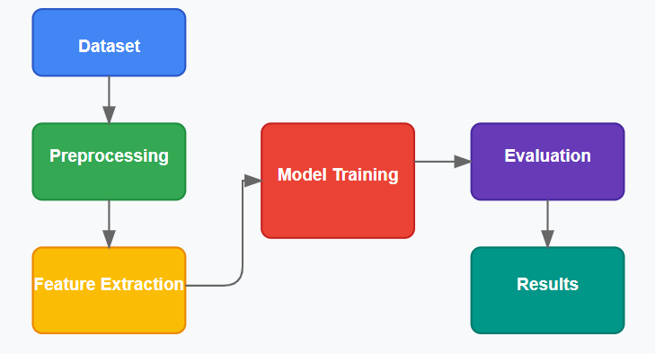
Flowchart

Slide 7
Dataset Characteristics
Dataset
We employed the IMDB dataset from Kaggle, which includes:
The dataset consists of 50,000 movie reviews, equally divided into 25,000 positive and 25,000 negative samples. It is split into 80% for training (40,000 reviews) and 20% for testing (10,000 reviews).
Feature Extraction
TF-IDF with 5,000 max features (for classical ML models)
Word embeddings (for LSTM, sequence length = 200)

Slide 8
Experiment Methodology
Preprocessing
Lowercasing
Removal of HTML tags
Removal of punctuation
Removal of stopwords (using NLTK)
Stemming (Porter Stemmer)

Slide 9
Experiment Methodology
Models & Parameters
Evaluation Metrics
Accuracy
Precision
Recall
F1-score
Confusion matrices
Model | Key Parameters
Naive Bayes | Default parameters
SVM | Linear kernel, max_iter=500
Random Forest | n_estimators=100, max_depth=None
Decision Tree | max_depth=5
LSTM | 128-unit LSTM, dropout=0.2

Slide 10
Results
4.1 Model Performance Comparison
Key Observations:
LSTM outperforms other models, benefiting from sequential text processing.
Naive Bayes and Random Forest perform similarly, suggesting that simpler models can be effective for this task.
SVM underperforms, likely due to high-dimensional sparse data.
Decision Tree has high recall but low precision, indicating overfitting to the majority class.
Model | Accuracy | Precision | Recall | F1-Score
LSTM | 87.65% | 87.12% | 88.59% | 87.85%
Naive Bayes | 84.91% | 84.58% | 85.67% | 85.12%
Random Forest | 84.72% | 85.57% | 83.81% | 84.68%
SVM | 71.60% | 71.32% | 72.99% | 72.15%
Decision Tree | 69.68% | 64.03% | 64.03% | 75.13%

Slide 11
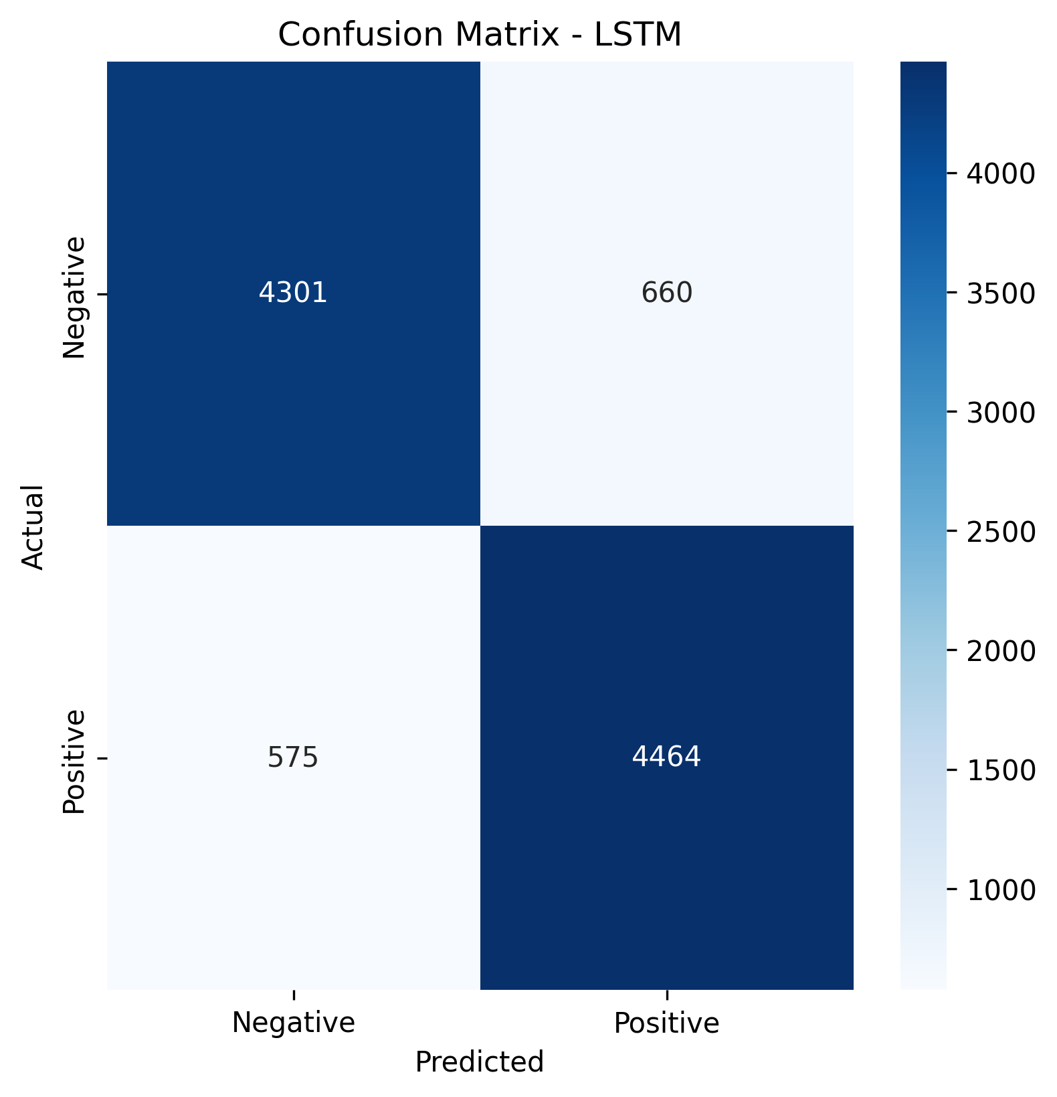
Results
A confusion matrix indicates that the LSTM model performs extensively well in sentiment analysis through its 4301 true negatives and 4464 true positives indicating effective classification. The model yielded 660 false positive classifications along with 575 false negatives while doing accurate sentiment detection in most cases. Analysis shows that the model demonstrates proficient performance because its diagonal values remain high which indicates it correctly distinguishes positive and negative sentiment in most situations.
Figure 1: Confusion Matrix for LSTM

Slide 12
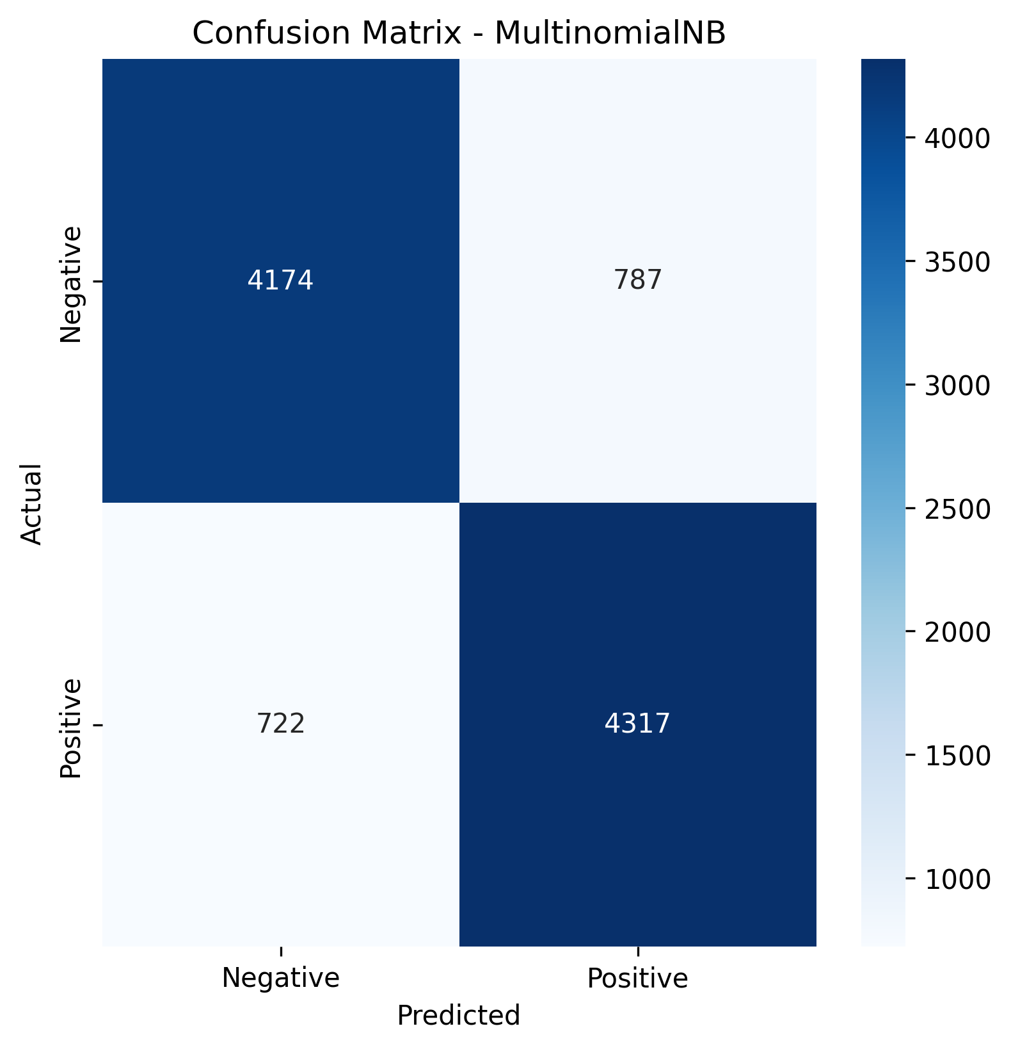
Results
The Multinomial Naive Bayes model achieves decent accuracy through its identification of 4174 true negatives and 4317 true positives for both sentiment classes.
The Multinomial Naive Bayes model has a higher misclassification rate than LSTM since it produces 787 false positives combined with 722 false negatives.
The Naive Bayes model proves its effectiveness for sentiment analysis tasks despite its basic structure because it competes with traditional approaches and deep learning methods.
Figure 2: Confusion Matrix for Naive Bayes

Slide 13
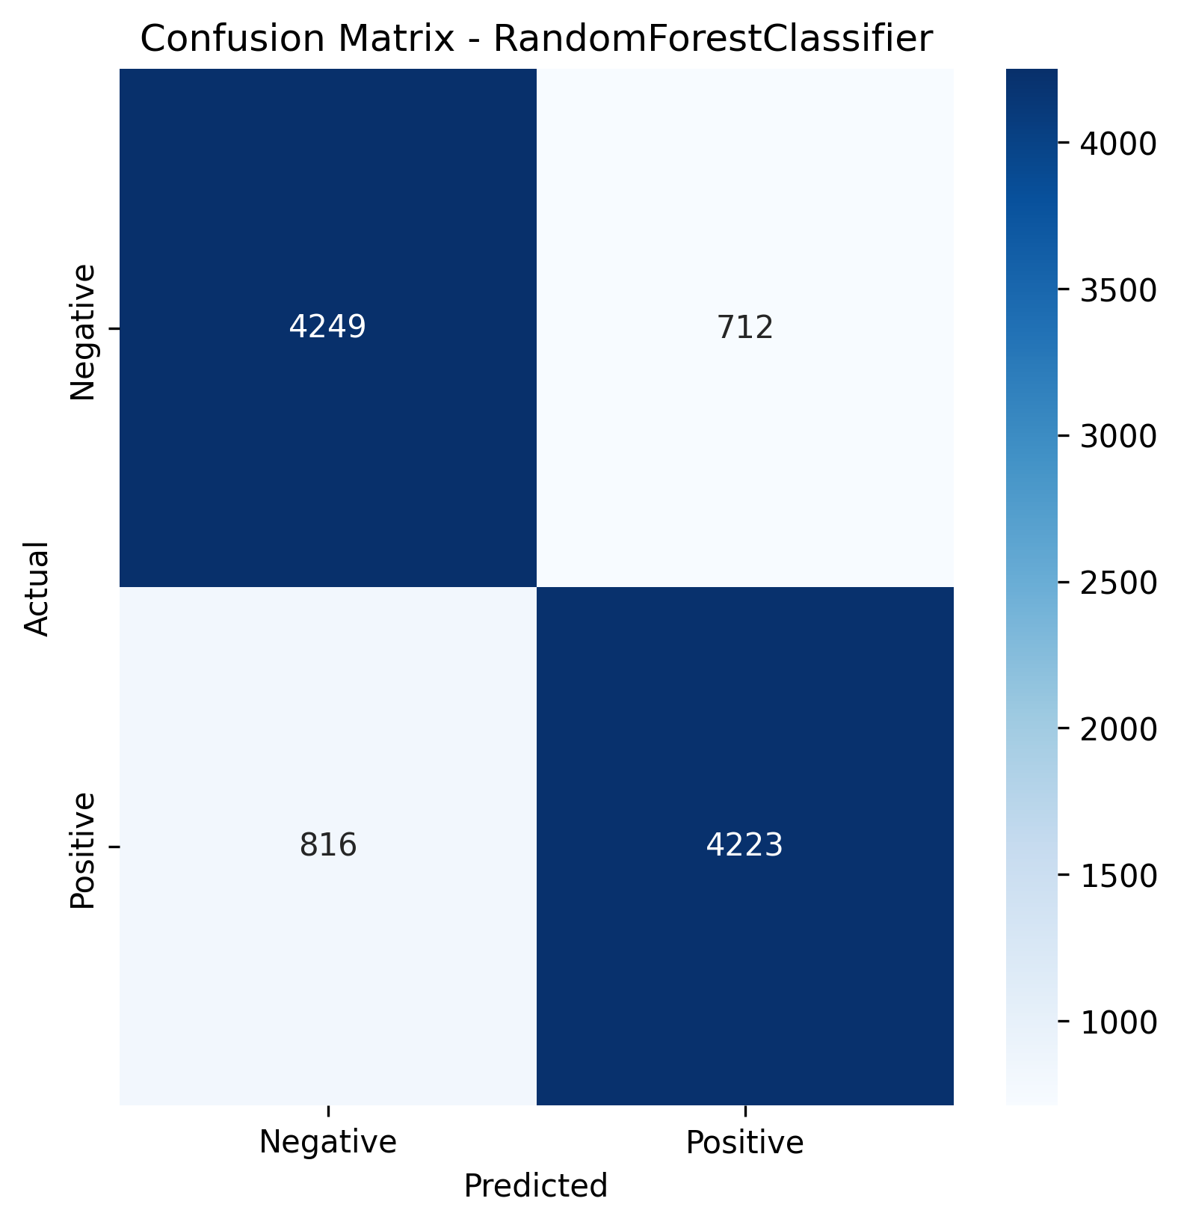
Results
It shows strong performance through its identification of 4249 true negatives and 4223 true positives equally across both sentiment classes.
The model failed to correctly identify 816 negative and 712 positive examples in total while producing slightly fewer errors on positive cases than negative ones.
The ensemble method demonstrates performance levels that match what both LSTM and Naive Bayes approaches achieve making tree-based methods suitable for sentiment analysis tasks
Figure 3: Confusion Matrix for Random Forest Classifier

Slide 14
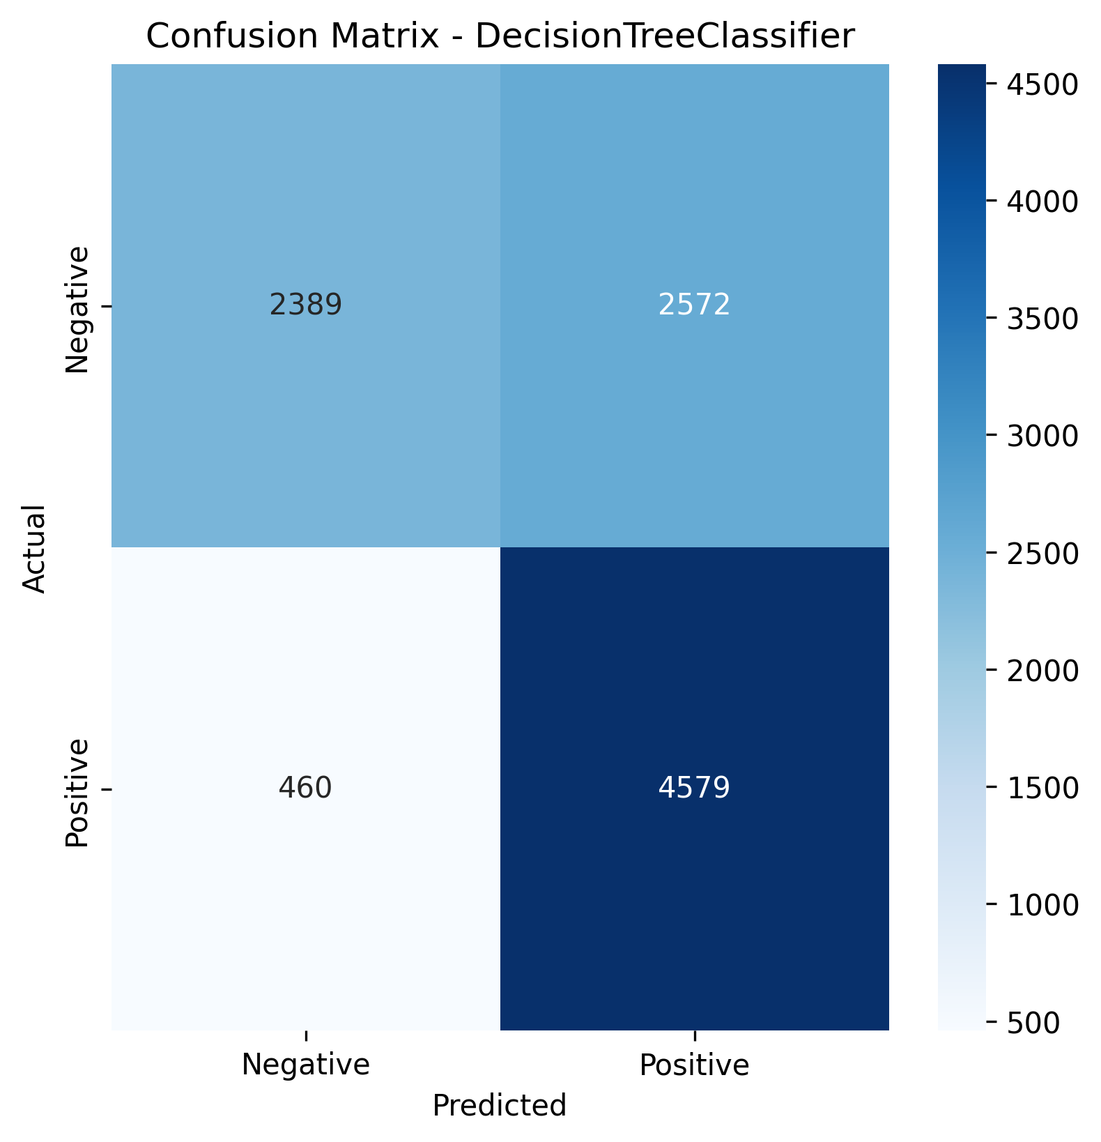
Results
Decision Tree Classifier produces inferior results following previous models because it fails to identify negative sentiments accurately.
A total of 4579 correct positive predictions emerges while only 2389 true negative categorizations arise alongside 2572 instances of incorrect positive predictions.
Its extreme bias toward positive sentiment prediction indicates this model provides unreliable results compared to the other LSTM, Naive Bayes and Random Forest models in balanced sentiment analysis tasks.
Figure 4: Confusion Matrix for DecisionTreeClassifier

Slide 15
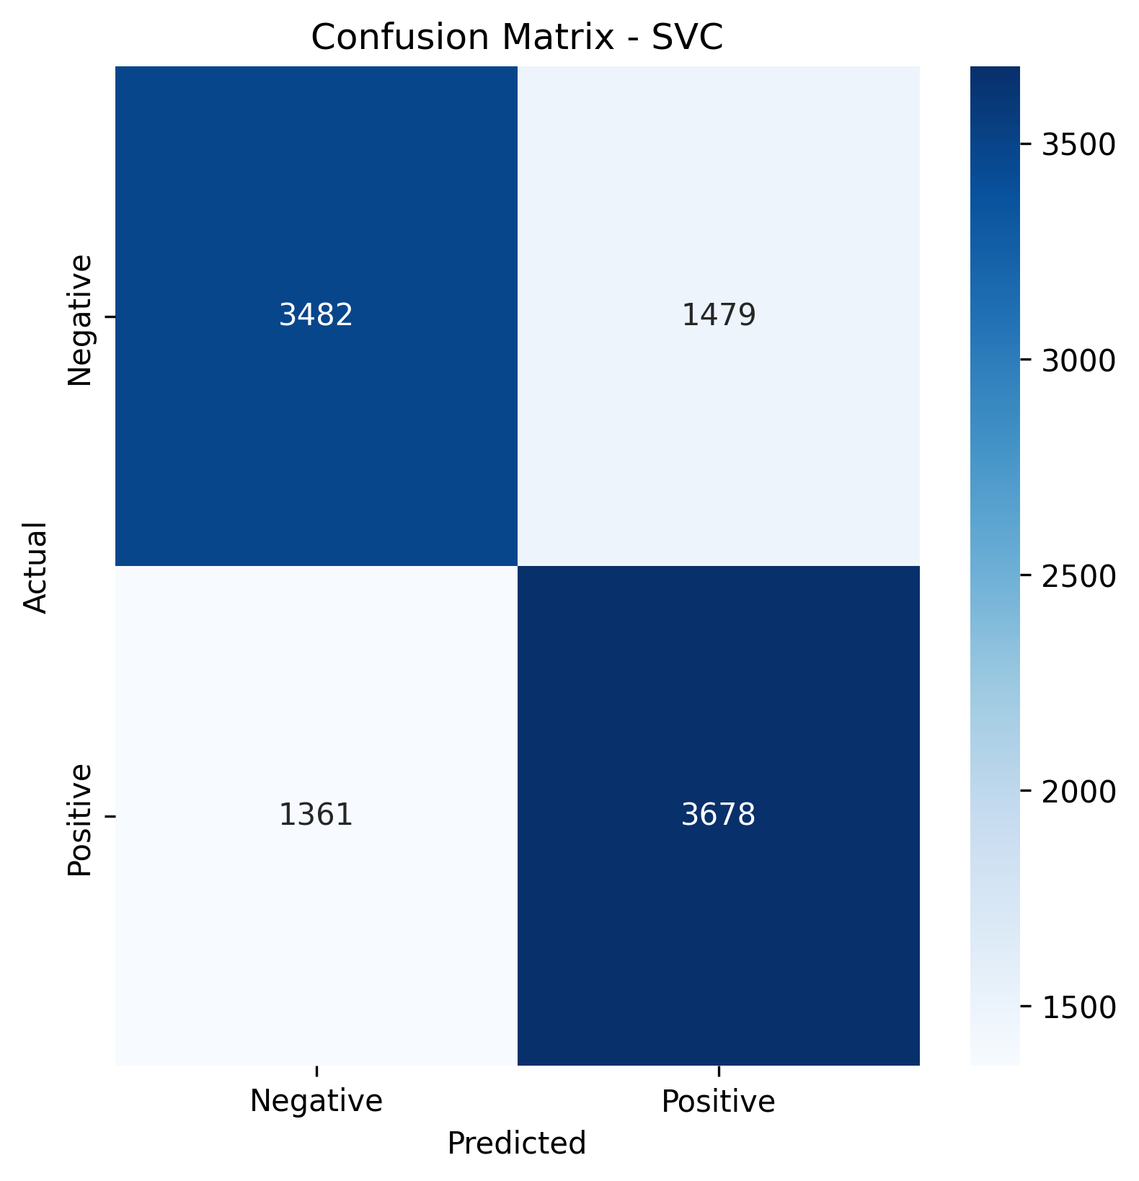
Results
An evaluation of SVC reveals overall decent accuracy along with 3482 correct negative predictions and 3678 accurate positive classifications however both classes show noticeable misclassification errors.
The model demonstrates below average accuracy rates because it produces 1479 false positives coupled with 1361 false negatives in its classifications.
Figure 5: Confusion Matrix for SVC

Slide 16
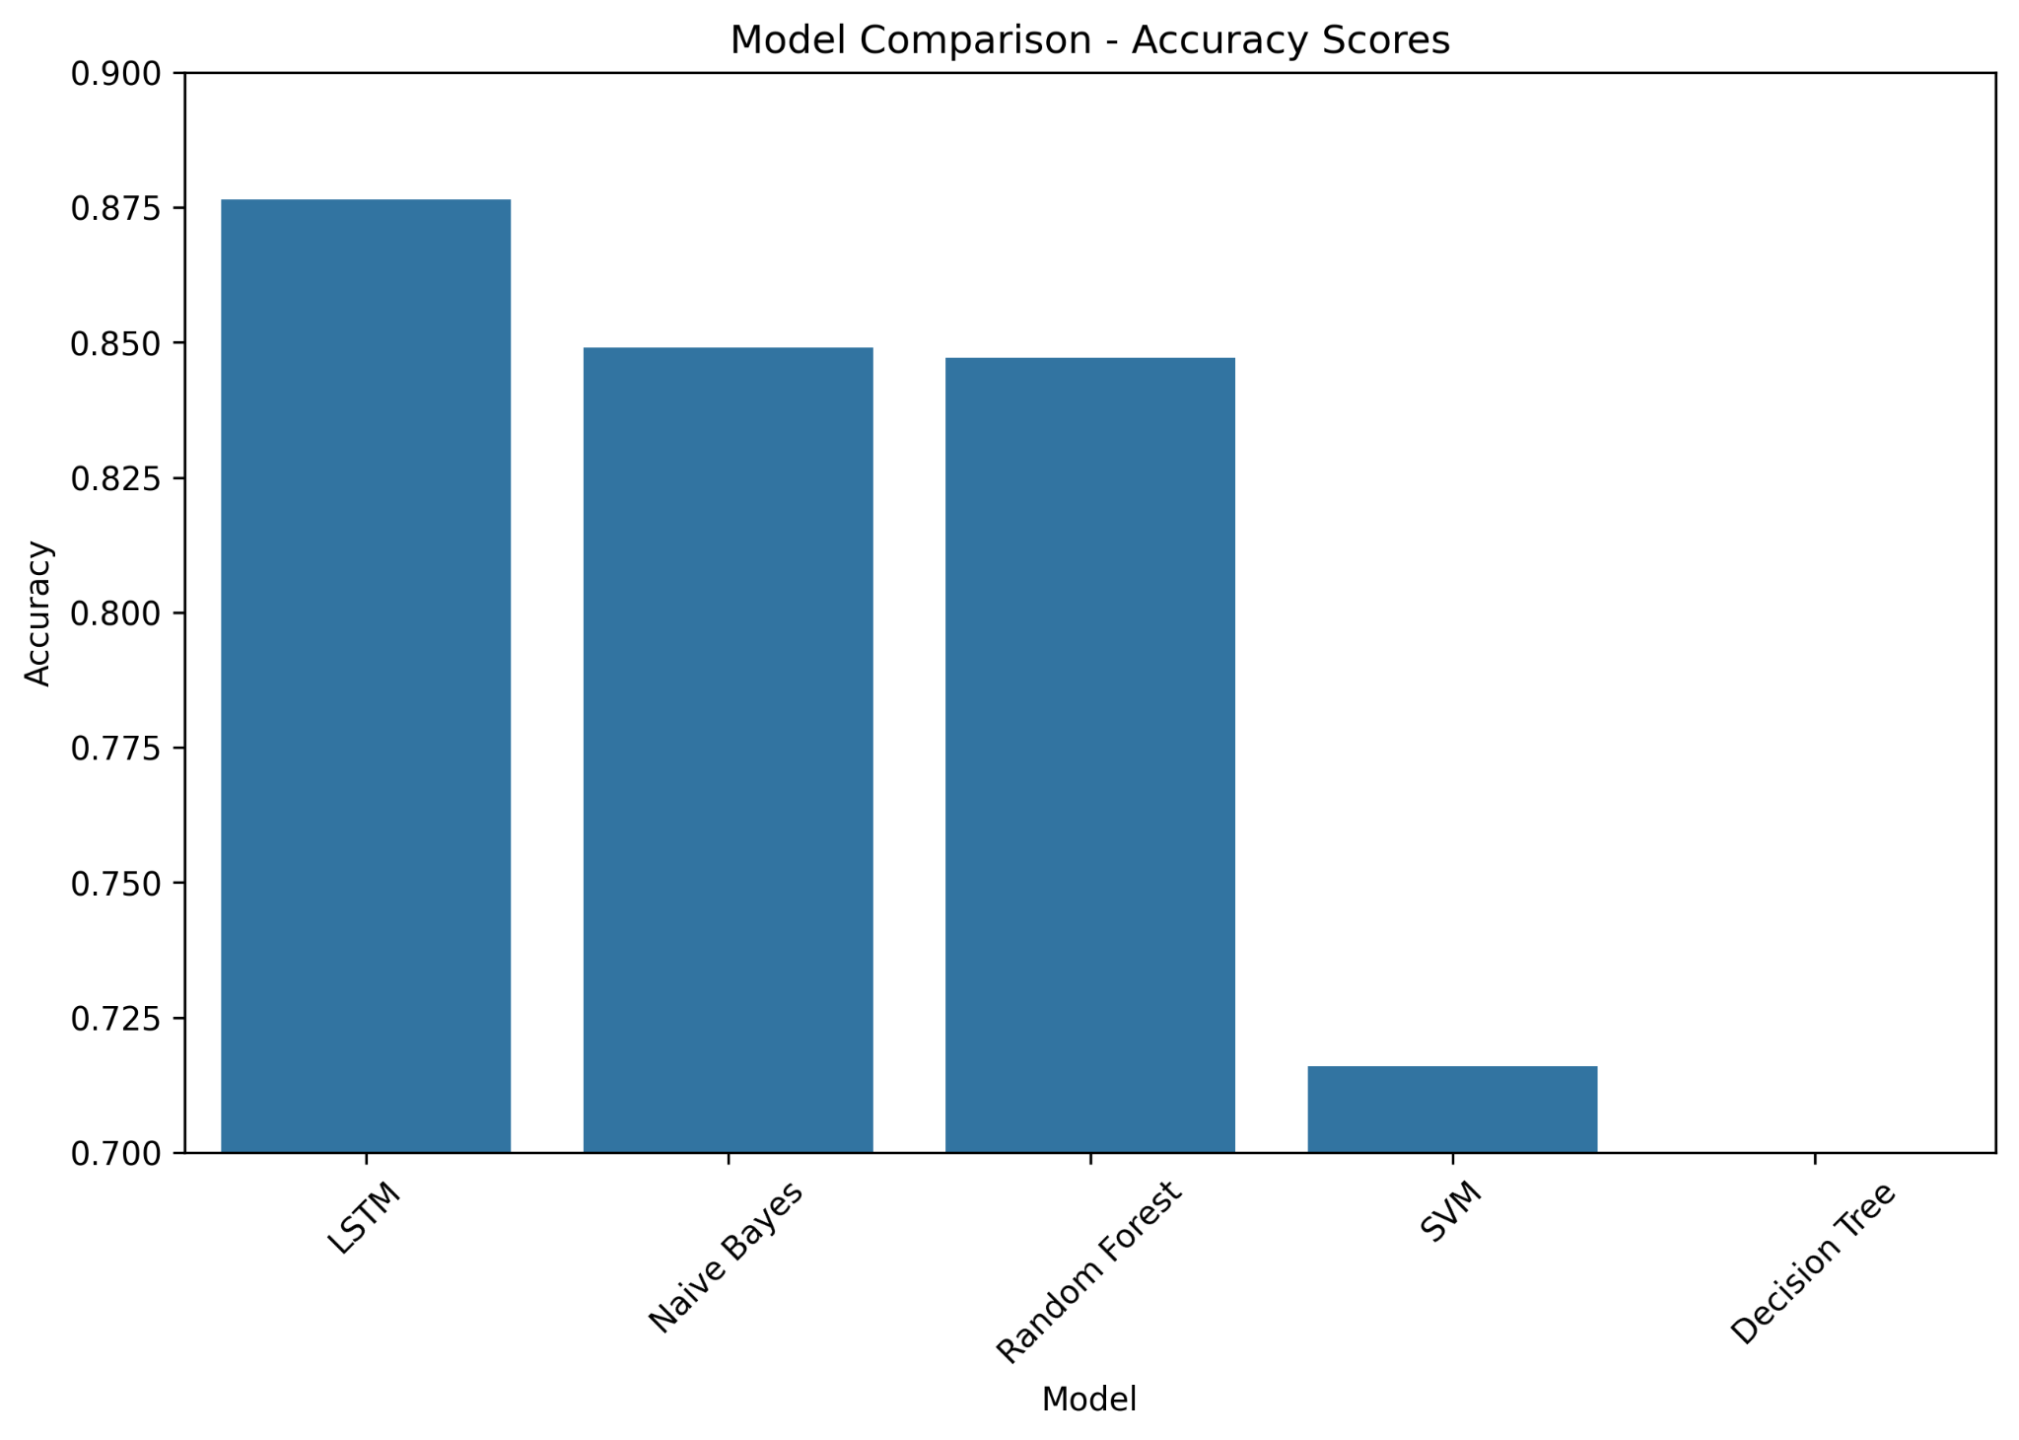
Results
The accuracy evaluation proves that LSTM delivers better results than competing models by achieving 87.5% accuracy thus demonstrating its excellence for sentiment analysis.
The traditional models Naive Bayes alongside Random Forest achieve almost equivalent results at approximately 85% accuracy even though their algorithms remain basic.
The results show that SVM obtains 72% accuracy along with Decision Tree reaching below 70% which supports the results in the confusion matrices regarding their struggles to correctly classify unbalanced sentiments.
Figure 6: Model Comparison by Accuracy Scores

Slide 17
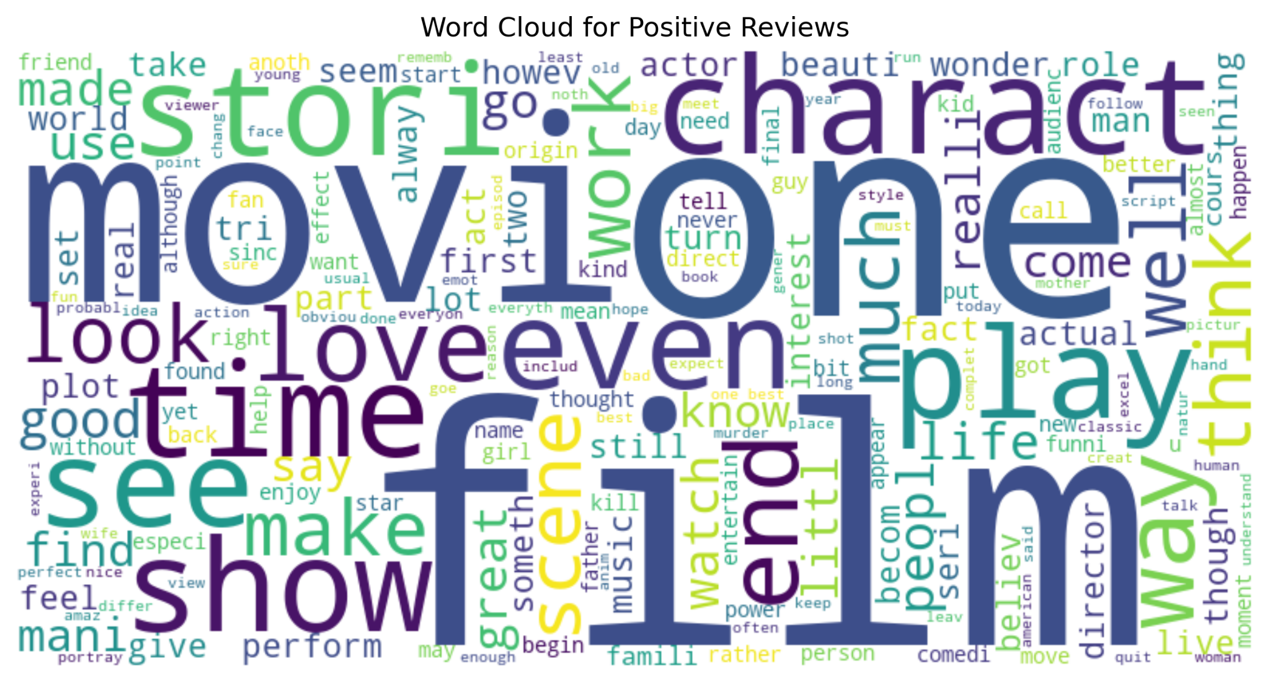
Results
Figure 7: Word Cloud - Positive

Slide 18
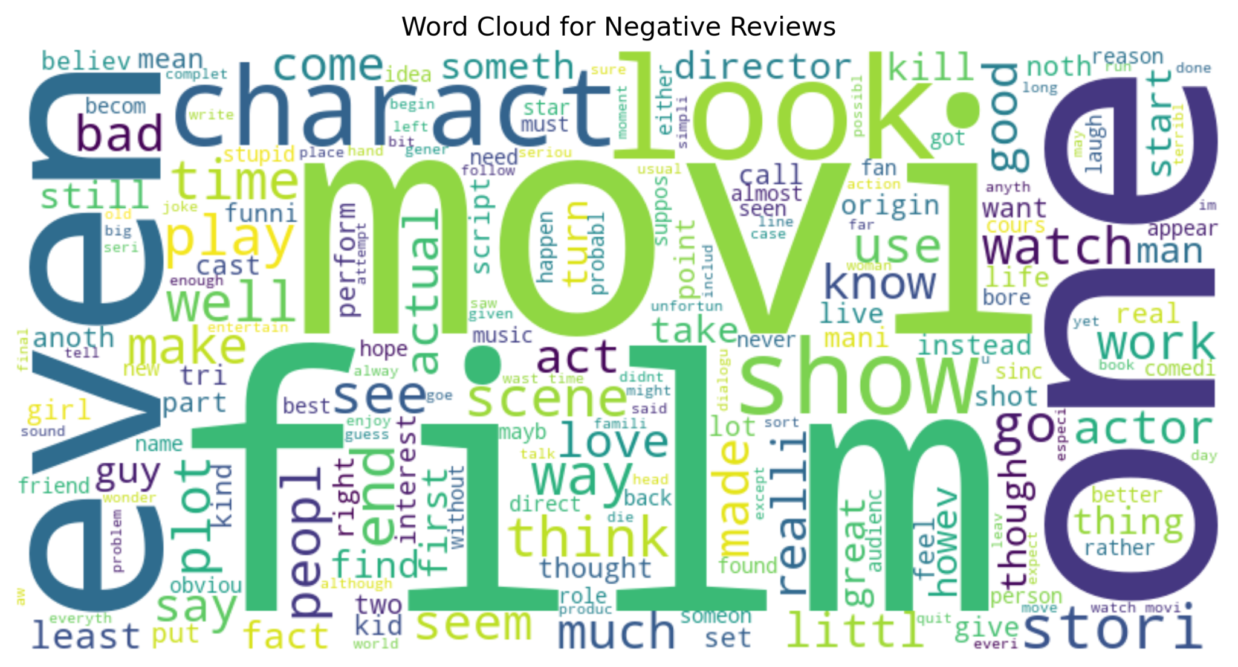
Results
Figure 8: Word Cloud - Negative

Slide 19
Limitations & Future Work:
Try BERT or Transformer-based models for better accuracy.
Fine-tune hyperparameters for enhanced SVM performance.
Investigate ensemble methods of combining LSTM and conventional classifiers.
Conclusion
Our experiments indicate that LSTMs perform best (87.65% accuracy) in IMDB sentiment analysis, then Naive Bayes and Random Forest.
SVM and Decision Trees performed very badly, probably because they cannot process sparse text data efficiently.

Slide 20
References
Pang, B., Lee, L., & Vaithyanathan, S. (2002). "Thumbs up? Sentiment Classification using Machine Learning Techniques.“
Kim, Y. (2014). "Convolutional Neural Networks for Sentence Classification.“
Wang, S., & Manning, C. D. (2012). "Baselines and Bigrams: Simple, Good Sentiment and Topic Classification.“
Hochreiter, S., & Schmidhuber, J. (1997). "Long Short-Term Memory.“
Mikolov, T., et al. (2013). "Efficient Estimation of Word Representations in Vector Space."

